Slide 1

WESTERN UNION CONVERA SUPPORT
UPDATE
Confidential January 13, 2022

Slide 2
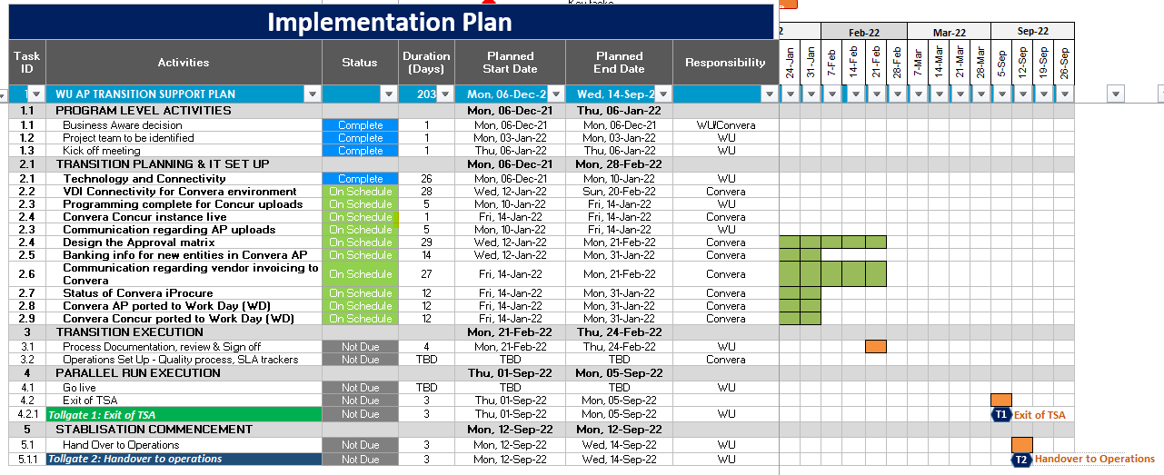

HIGHLEVEL IMPLEMENTATION PLAN AND STATUS

Slide 3
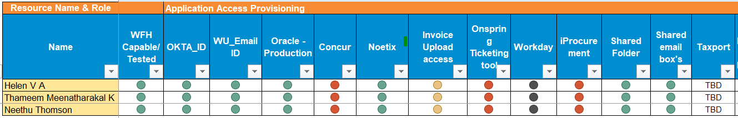
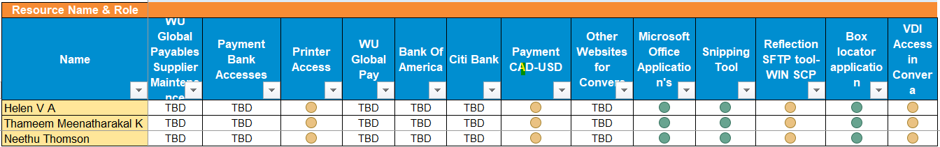
ACCESS PROVISIONING STATUS
- Total resources as part of this transition is 3

Slide 4
RISKS LOG
Sl NO | Risk Category | Risk Description | Impact | Action to Mitigate | Risk Owner | Status
1 | Process | Vendor master creation of new entities | High | Vendor details for new entities is required | Convera | Open
2 | Process | Approver matrix-Not received the approver list | Medium | Convera to provide the details | Convera | Open
3 | Process | Segregation of Duties (SOD) | Medium | As the team size is small, Segregation of duties might not be applicable at this stage but will be required at later stage | Convera | Open
4 | Process | Minimal information on volumes for new entities | Medium | Team to review the volumes for next 2 months | WU | Open
5 | Process | Communication to vendors on WU-Convera separation | Medium | Vendors to be informed about the change & request them to provide invoices to WUBS (Convera) shared mail box | WU | Open
6 | Process | Training on AP uploads to the requestor | High | >>Is there any mechanism where system does not allow the incorrect GL codes, this needs to be confirmed >>Train the requestors & provide them with the correct GL codes information | WU | Open
7 | Process | Duplicate checks are not performed | High | Implement EXL’s fraudulent check tool | Convera | Open
8 | Process | ACH payment method and check payment method : Positive pay file transfer to bank is not developed by IT in Convera system | High | Technology team has to provide these details | IT | Open
9 | Technology | Access to bank information | Medium | Payment file to be sent to treasury team so that they can release the payment | WU | Open

Slide 5
RISKS LOG
Sl NO | Risk Category | Risk Description | Impact | Action to Mitigate | Risk Owner | Status
10 | Technology | IT communcation plan does not exist | High | Create an IT communication plan | WU / IT | Open
11 | Technology | Concur login | Low | Link to a website or log in page, password to be provided | WU / IT | Open
12 | Process | Final reconciliation of credit card transactions | Medium | To monitor the unreconcilled expenses, | WU | Open
13 | Technology | VDI access within the WU environment | High | VDI access to continue in WU environment during the TSA period | IT | Open
14 | People | No buffer when it comes to count of resources | Low | Currently assigned experienced resources hence buffer might not be required | WU | Open
15 | People | Shared resource for vendor management between WU & Convera | High | Additional resource required for vendor management | WU / Convera | Open

Slide 6
ACTION LOG
Sl. No. | Actions | Responsible | Target Completion | Status
1 | Finalize responsibility matrix | Both | Fri, 21-Jan | On Schedule
2 | To-be process maps for each process | WU | Mon, 28-Feb | On Schedule
3 | Performance testing on ERP | WU | Sun, 09-Jan | Completed
4 | Start processing pending invoices in Convera environment | WU | Mon, 10-Jan | On Schedule
5 | Citrix access needs to be changed to Convera environment | Convera | Mon, 28-Feb | On Schedule
6 | Reporting structure needs to be added | Convera | Mon, 28-Feb | On Schedule
7 | Payment access is there or not needs to be verified for all resources | WU | Fri, 14-Jan | On Schedule
8 | Backlog: Pending invoices to be processed | WU | Fri, 21-Jan | On Schedule
9 | Cancel all credit cards of WUBS employees | WU | Tue, 01-Mar | On Schedule
10 | Terminate concur profiles of WUBS employees | WU | Tue, 01-Mar | On Schedule

Slide 7

Thank you

